Slide 1
Digital Visual Culture with third graders: Animation, VoiceThread and web building in the art room
A project funded by the NAEF: National Art Education Foundation
Patty Bode bode.40@osu.edu
The Ohio State University
Department of
Arts Administration, Education & Policy
pattybode.com

Slide 2
Assumptions and assertions undergirding this work:
“Art education as a civil right and human right”
-Patty Bode
sociopolitical context of critical multicultural education
disrupting grand narratives - considering counter-narratives
critical race theory
critical pedagogy

Slide 3
Sociocultural Perspective
Conceptualize culture and identity as fluid and unstable.
Forward the voices of participants.
Focus on language, literacy and culture.
Challenge popular conceptions of curriculum.

Slide 4
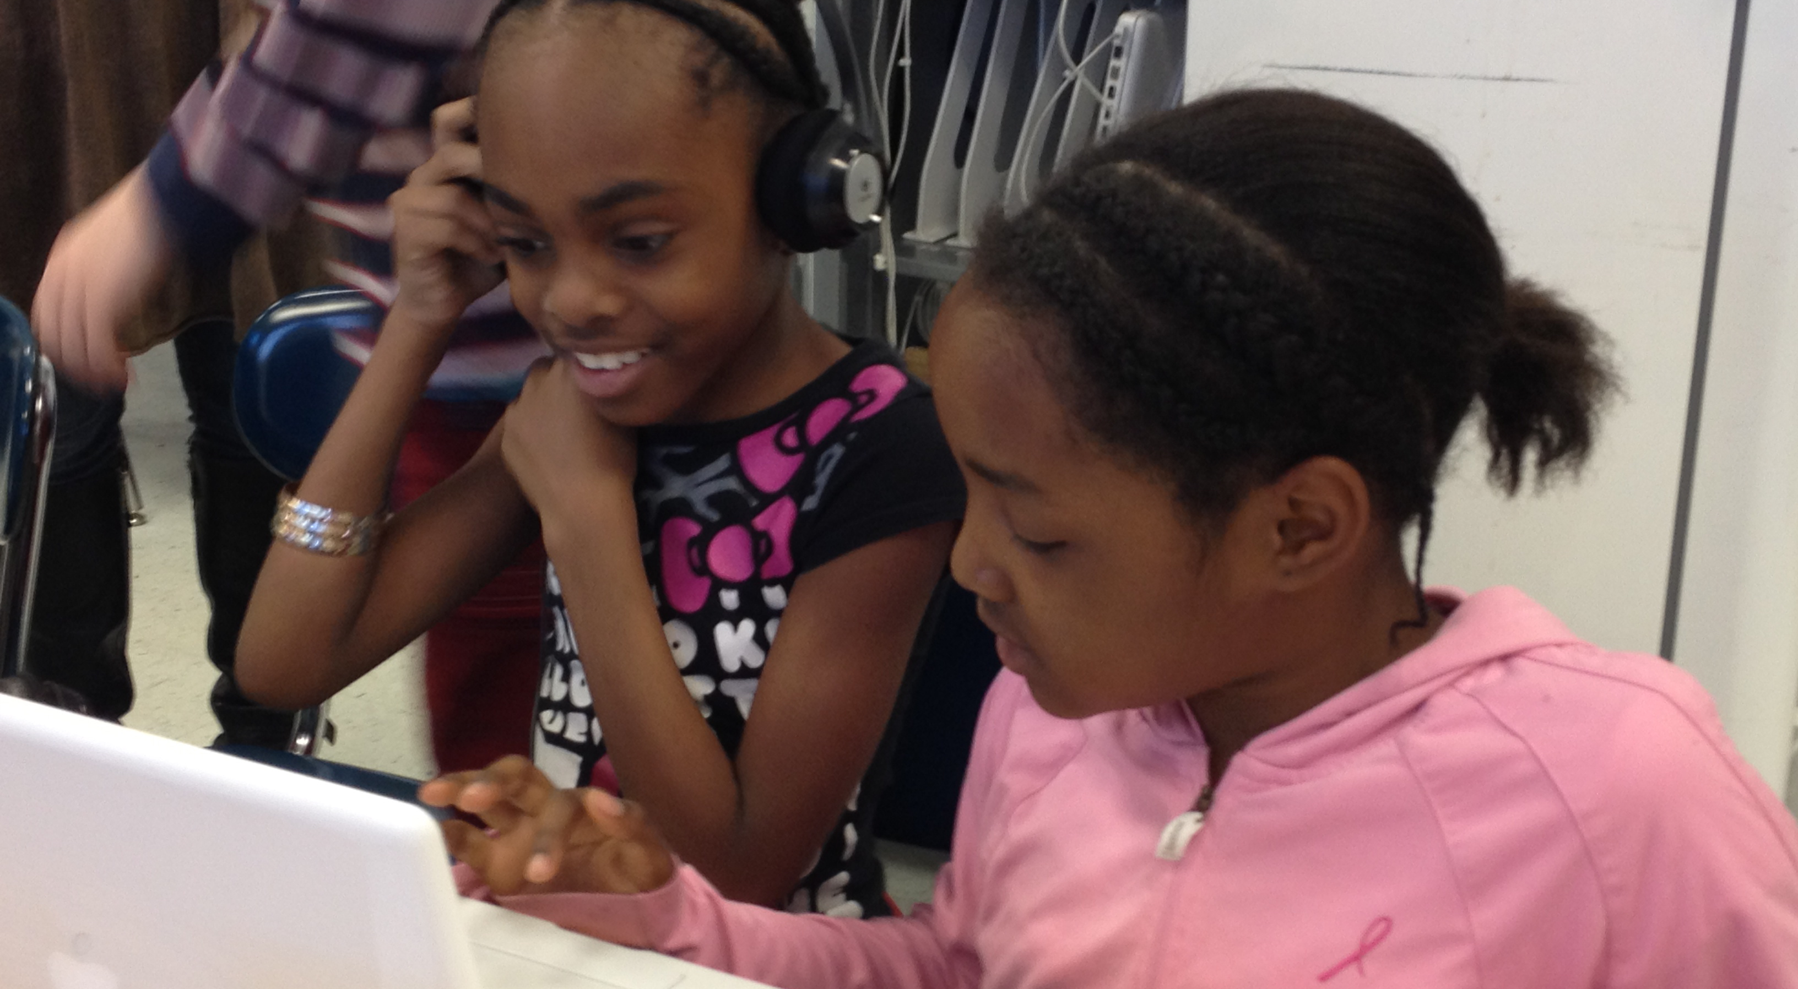
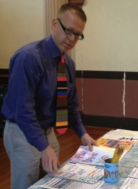
Digital Visual Culture Project: NAEF-funded 2011-2012 CONTEXT: PARTICIPANTS & SETTING
Boston Teachers Union School
theunionschool.com
Laura Davila-Lynch, art teacher
Jeffrey Timberlake, third grade teacher
25 third graders (third grade scholars)
Laura Davila-Lynch
with Berta Beriz
Third Grade Scholars
Jeffrey Timberlake

Slide 5
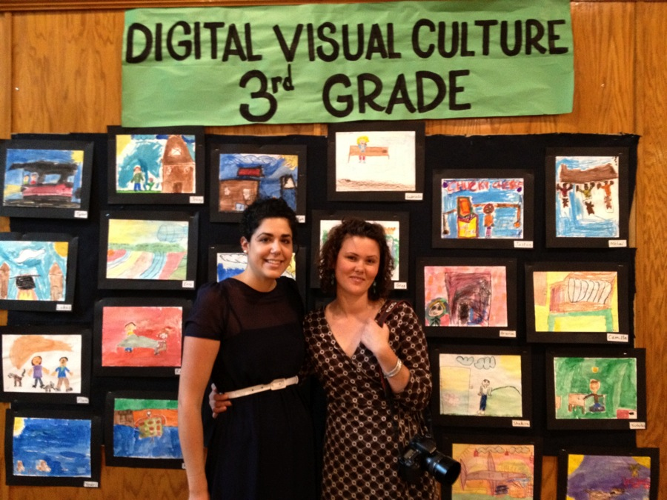
Digital Visual Culture Project: NAEF-funded 2011-2012 Research team:
Elana McDermott
Pearl Emmons
TUFTS UNIVERSITY, Boston Massachusetts
Elana McDermott, Research Assistant
Pearl Emmons, Project Manager & Multimedia specialist
Patty Bode, Principle Investigator

Slide 6
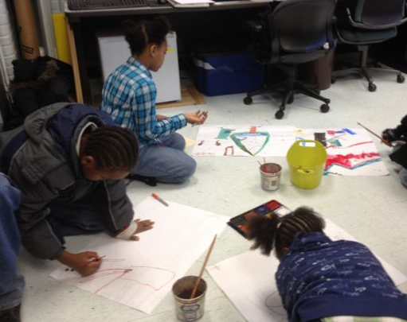
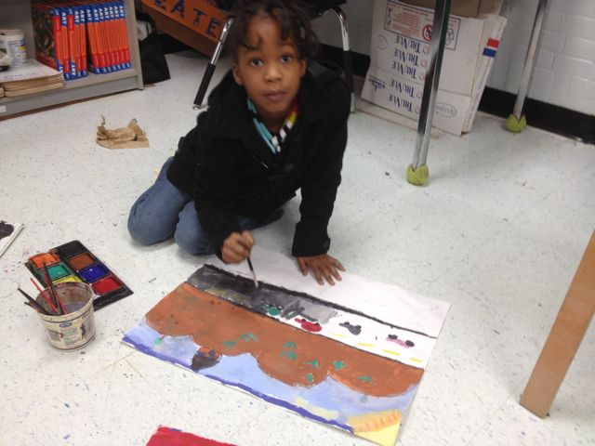
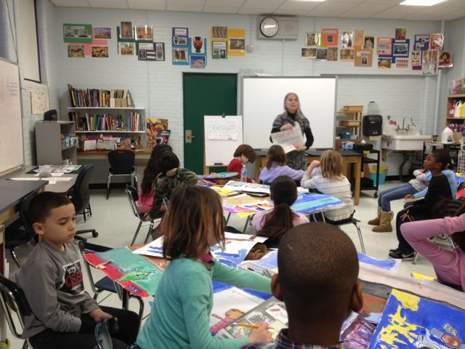
Traditional studio materials
and art-making literacies

Slide 7
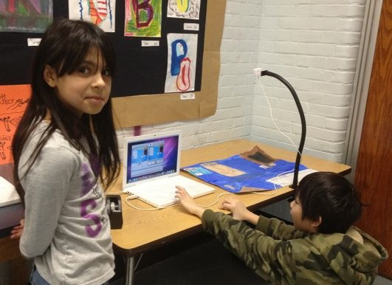
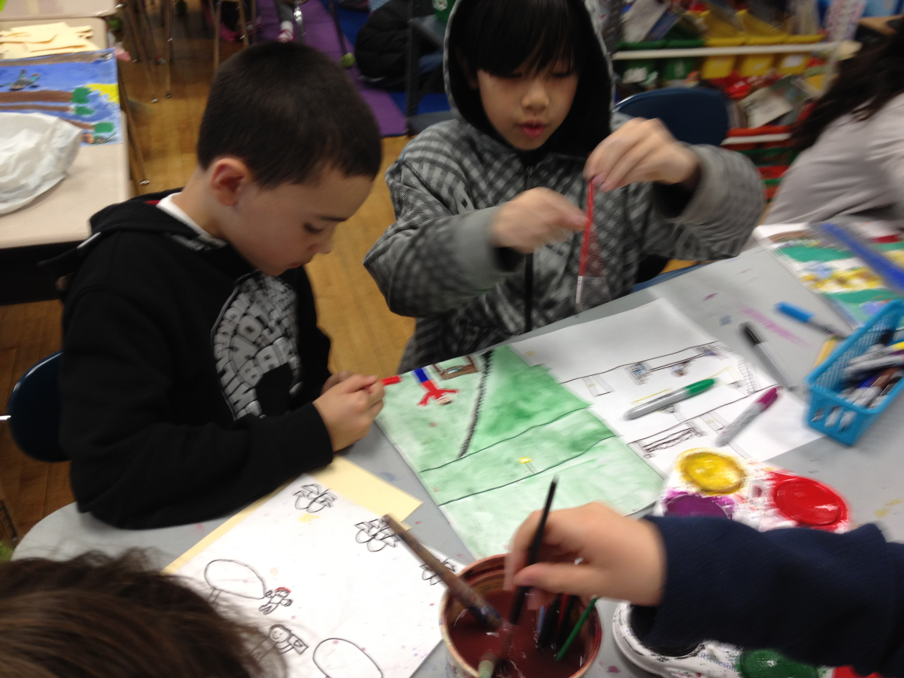
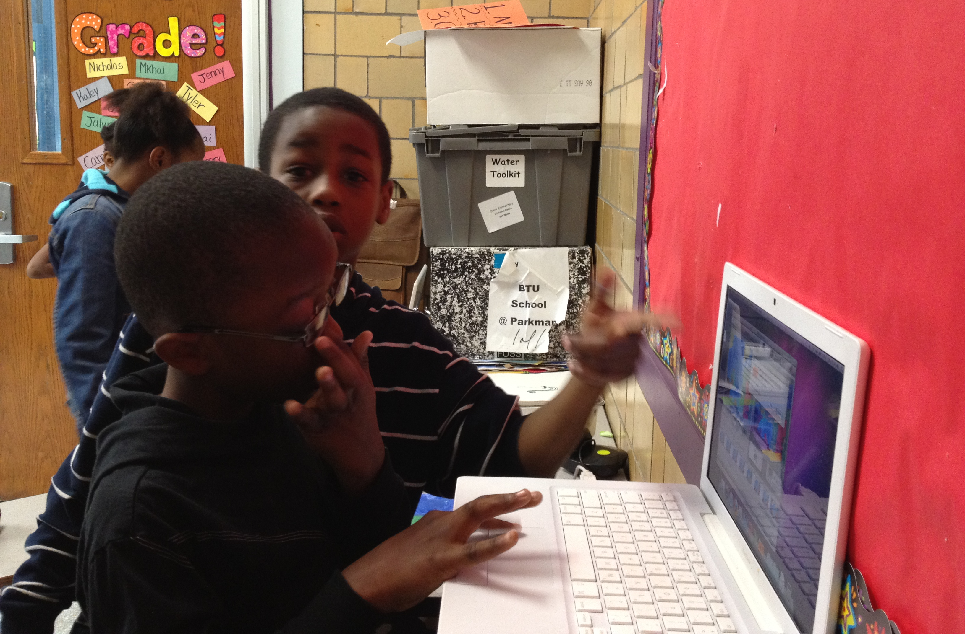
Intersecting art-making literacies,
reading & writing literacies with technology literacies

Slide 8
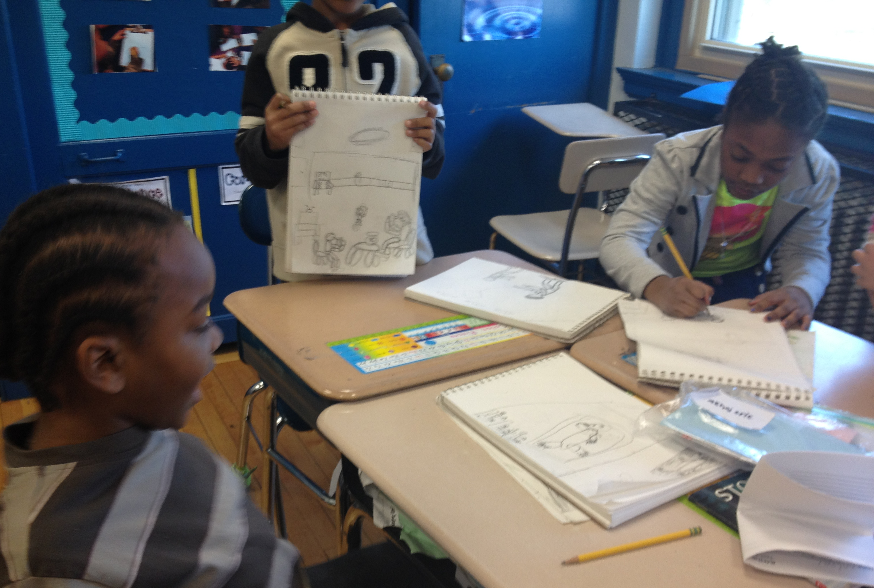
First Quarter: sketchbooks & relationships

Slide 9
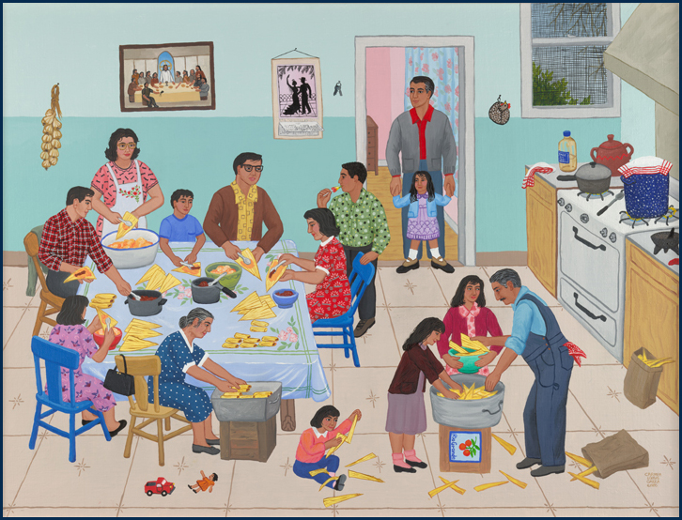
Carmen Lomas Garza

Slide 10
Zoom-in on a section of your sketch to enlarge into an 18 x 24 painting

Slide 11
1st Quarter:
Learn About Sketching and Painting
Click here:
http://www.pattybode.com/digitial-visual-culture-project-bps.html
To see video 2 minutes, 47 seconds
1st Quarter of Digital Visual Culture (DVC) Project: Learn About Sketching and Painting

Slide 12
2nd Quarter: 1 painting & 1 video animation

Slide 13
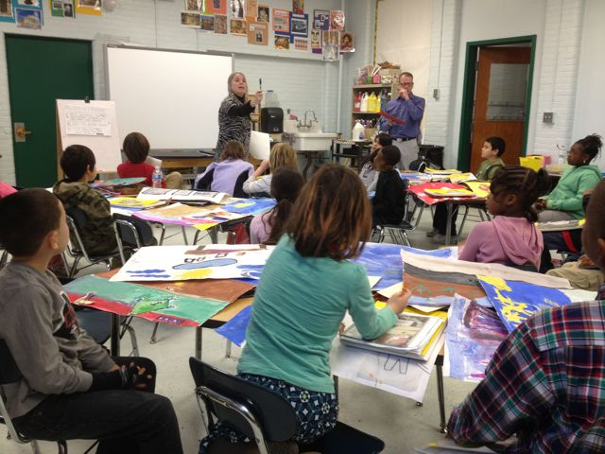
What is the one thing in your story/painting that you will make come alive – or animate?

Slide 15
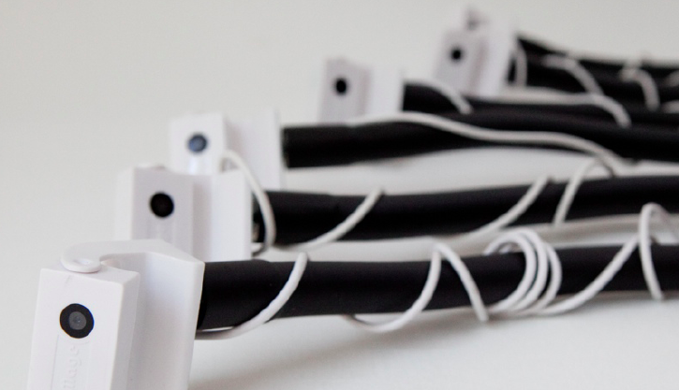
SAM iCreatetoEducate
http://icreatetoeducate.com/

Slide 16
2nd Quarter: Turn Illustration Into Animation
Click here:
http://www.pattybode.com/digitial-visual-culture-project-bps.html
To see video 2 minutes, 31 seconds
2nd Quarter of Digital Visual Culture (DVC) Project:
Turn Illustration Into Animation

Slide 17
Qualitative Research and
Choices in Methodology
Case Studies are a specific approach within the framework of qualitative research.
Sharan Merriam (2009) explains case studies as:
Particularistic (focusing on one person or one social unit).
Descriptive (because the result is a rich, think portrait) and
Heuristic (because it sharpens the reader’s understanding, leading to discovering new meanings).
Merriam, S. B. (2009). Qualitative Research: A Guide to design and implementation. Hoboken: Jossey-Bass.

Slide 18
Flexible Research Design
Empirical Data
(field notes, video, photo, artifacts, interviews)
Refined Fieldwork
Flexible Research Design
Constant comparative method
(Glaser & Strauss, 1967)
Dialectical work
of portraiture
(Lawrence-Lightfoot, 1997)
Reflexive Science
(Burawoy, 1998)
Emergent Themes
(Lawrence-Lightfoot, 1997)
Meta Codes
(Miles & Huberman, 1994)

Slide 19
CRITICAL ETHNOGRAPHY
Empircl.
Data
Refined
Fieldwrk
Flexible Research Design
EmergntThemes
Meta Codes
PARTICIPANT
OBSERVER
PAR
PARTICIPATORY
ACTION
RESEARCH
ABER
Arts-Based Educational Research
(Barone & Eisner, 2006)
Extended case study (Burawoy, 1998)
Burawoy, M. (1998). The Extended case study method. Sociological Theory, 16(1) pp. 4-33.

Slide 20
Extended case study method:
..real events, struggles, and dreams that took place over space and time.
…discrepancies between normative prescriptions and everyday practices –
Discrepancies they traced to internal contradictions but also to the intrusion of
colonialism.
- Burawoy, M. (1998).

Slide 21
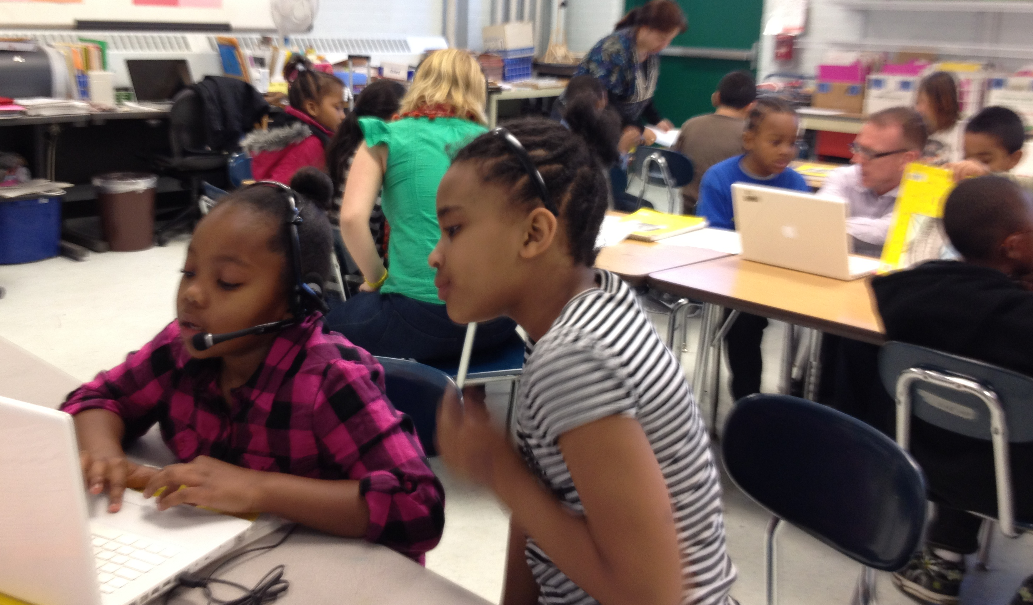
METHODOLOGIES Digital Natives: What counts as knowledge?
Participatory Action Research
PAR
(Kincheloe & McClaren, 1998)
Ernest Morrell (2006) asserts that PAR
“fundamentally questions who has the right to engage in research positioning students, community members, and K-12 literacy teachers as legitimate and integral participants in the research process.”

Slide 22
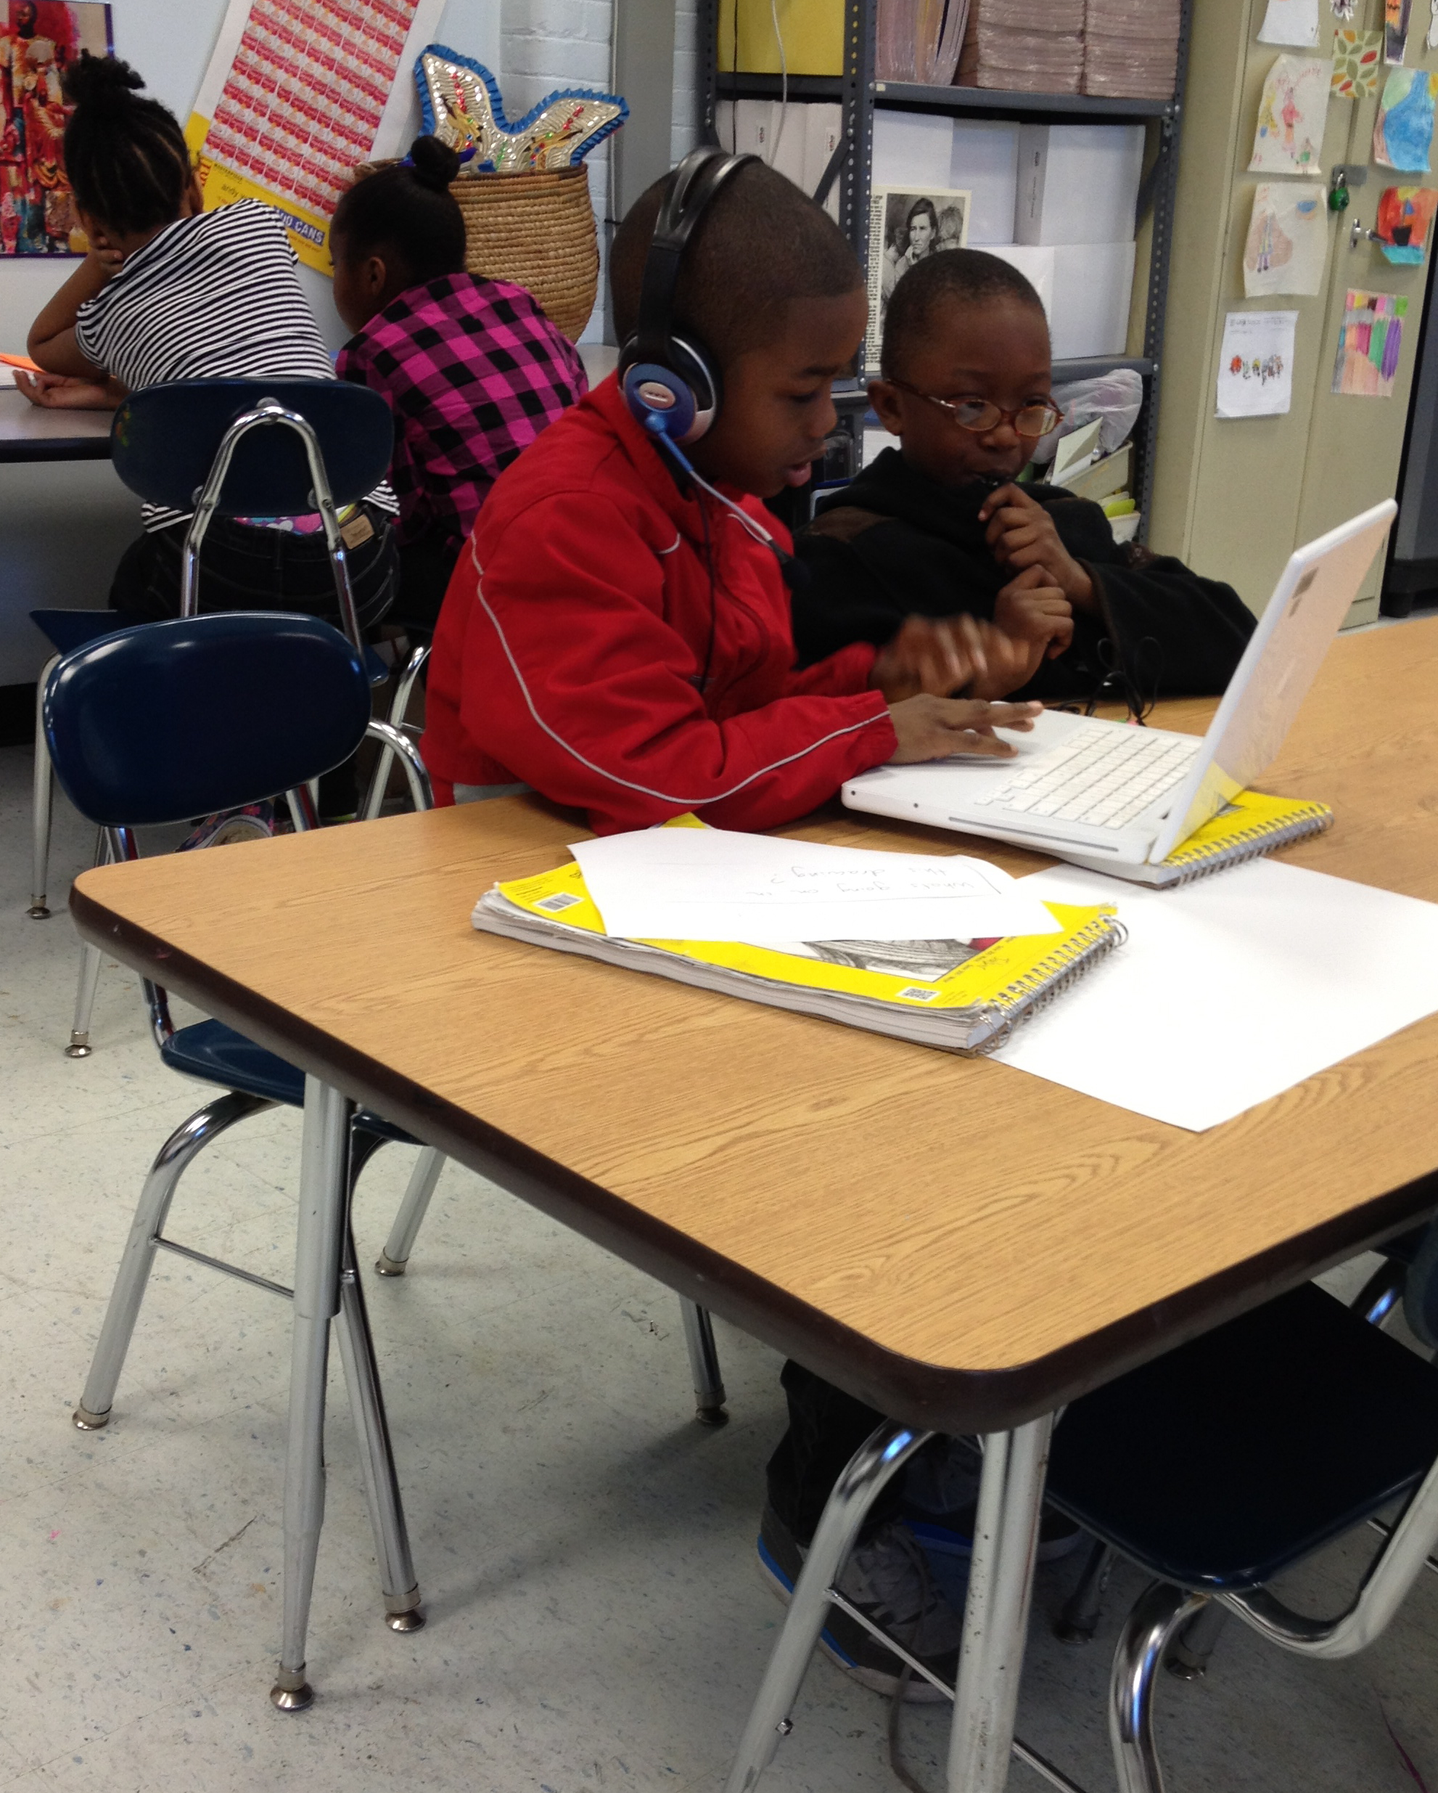
3rd quarter
Voicethread
participation and
video interview reflection

Slide 23
Voicethread http://voicethread.com/

Slide 24
3rd quarter: Reading Partnerships and Voicethread
Click here:
http://www.pattybode.com/digitial-visual-culture-project-bps.html
To see video 4 minutes, 04 seconds
3rd Quarter of Digital Visual Culture (DVC) Project: Reading Partnerships and Voice Thread

Slide 25
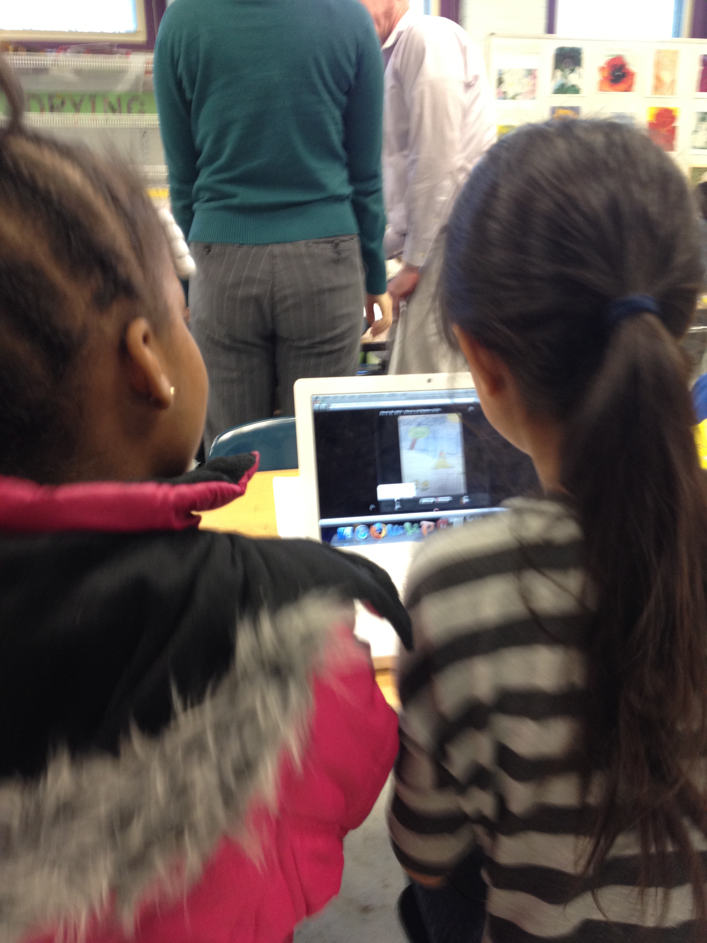
Research Questions
NAEA Research Agenda: Learning strand
How does integrating digital visual technology in art curriculum, instruction, and assessment meet the needs of multicultural classrooms & contribute to preparing diverse teachers and students for a global and just society?
What is the impact on student learning and on the broader context of visual art curriculum when technologies such as digital image production through video and photo are integrated into urban art classrooms that have previously maintained traditional studio art instruction?

Slide 26
Research Questions
NAEA Research Agenda: Research & Knowledge
How can art teachers in K-8 urban public schools become researchers, and be valued for their expertise, insights and multicultural perspectives?
How can K-8 student knowledge and voice influence how multicultural art teacher preparation programs may be reshaped for the postmodern era?
How can participatory action research presented in case study format contribute to dialog regarding use of digital visual technologies in K-8 classrooms in art education research agenda?

Slide 27
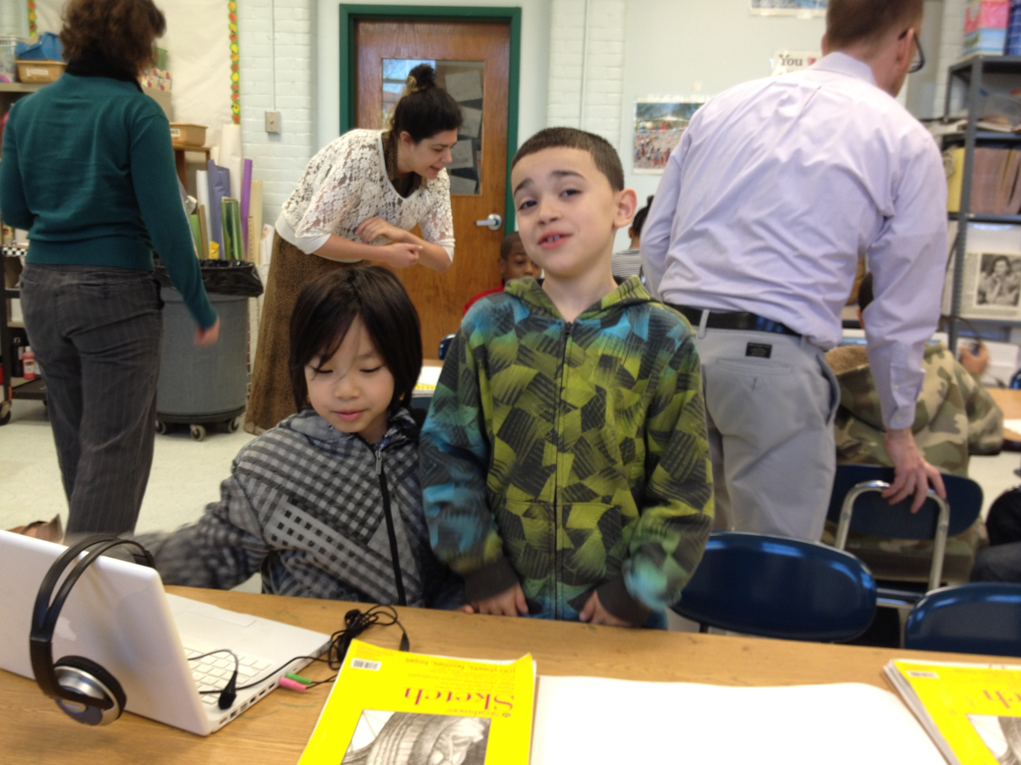
4th quarter
Partner Video-Animation
and Web site building

Slide 28
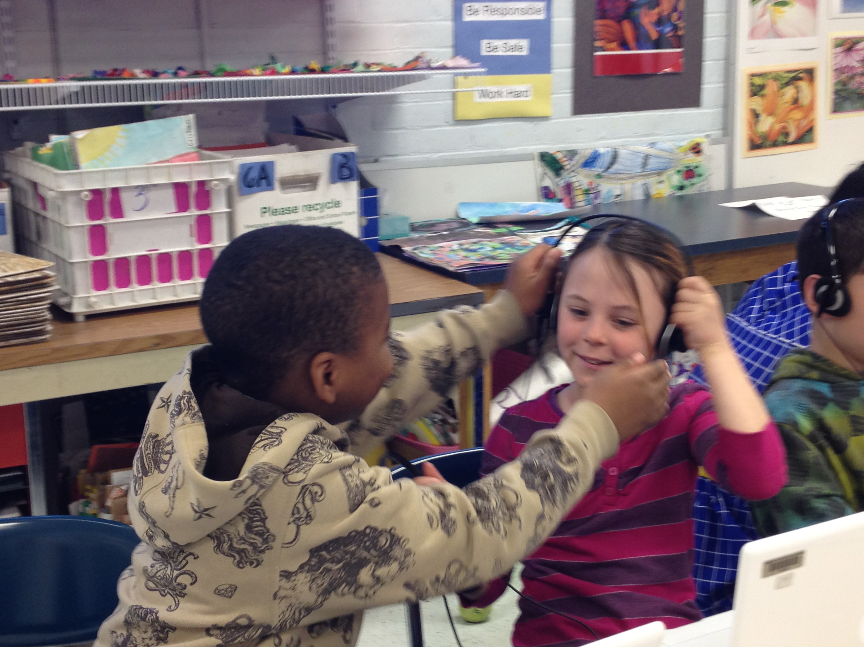

Slide 29
4th quarter: Animations and Websites
Click here:
http://www.pattybode.com/digitial-visual-culture-project-bps.html
To see video 2 minutes, 54 seconds
4th Quarter of Digital Visual Culture (DVC) Project: Animations and Websites

Slide 30
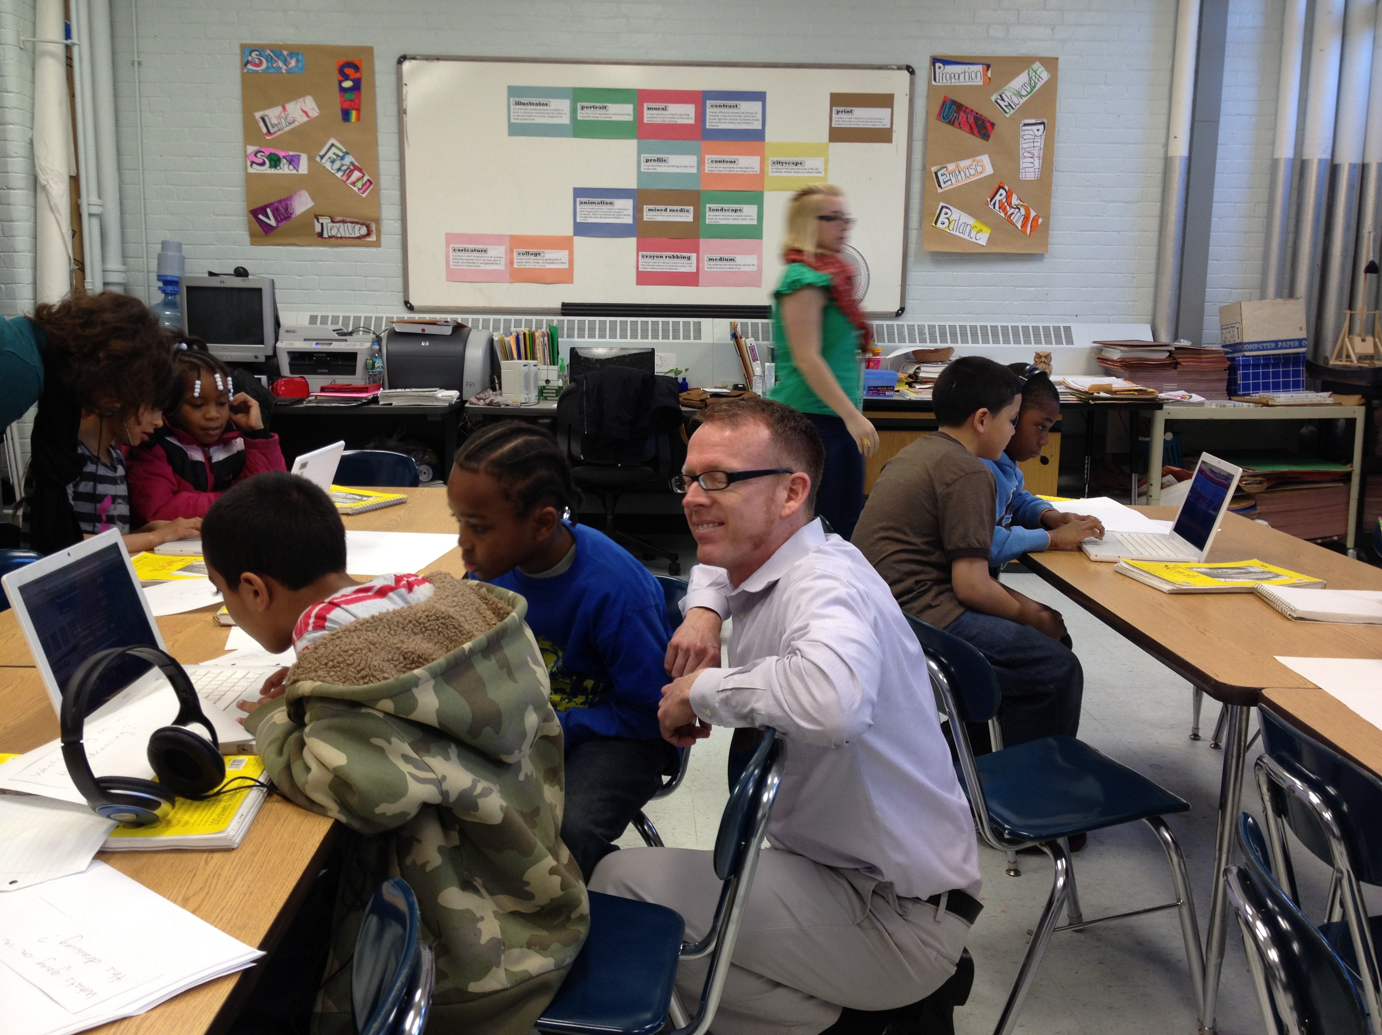
FINDINGS
Life is messy with paint & glue and life is messy with technology
Technology is more than
a tool: it is literacy
We (teachers) learn the most when we allow our
students to surprise us.
Flexibility in all things makes literacies and learning successful

Slide 31
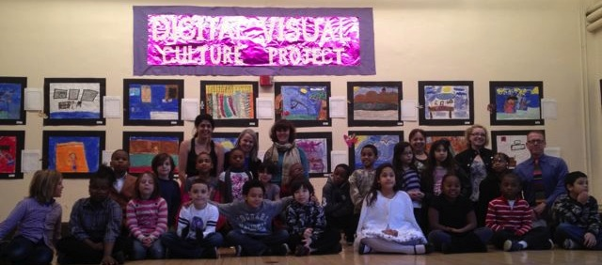
IMPLICATIONS

Slide 32
IMPLICATIONS
An art teacher, and a third grade teacher in a K-8 urban public school became researchers and were valued for their expertise, insights and multicultural perspectives.
By re-shaping teacher stance on student knowledge and harnessing digital native student-expertise, integrating digital visual technology in art curriculum, instruction, and assessment can help to meet the needs of multicultural classrooms and contribute to preparing diverse teachers and students for a global and just society.
The impact on student learning became visible and on the broader context of visual art curriculum when technologies such as digital image production through video, photo and web design are integrated into urban art classrooms that have previously maintained traditional studio art instruction.
Interdisciplinary approaches with the English language arts curriculum and art curriculum shift student and teacher perspectives on what counts as literacy paving avenues for critical literacy practices.
Student knowledge and voices from the K-8 settings – specifically third grade - influenced the researchers’ thinking on how multicultural art teacher preparation programs may be reshaped for the postmodern era.
Participatory action research presented in case study format will contribute to dialog regarding use of digital visual technologies in K-8 classrooms in art education research agenda.

